Slide 1
ASTRA satellites
- unique distribution mean across Central Eastern Europe
P-Sat Professional Day
Budapest, October 2011

Slide 2
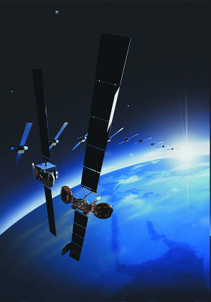
Introduction to SES
Leading satellite operator in Europe
17 satellites at 6 orbital positions in Europe
135 mil homes connected to ASTRA satellites
Nearly 2600 TV & radio channels available
Headquarter in Luxembourg
12 affiliate offices in Europe & Africa
ASTRA office in Warsaw as a hub for CEE region
with regional office located in Bucharest

Slide 3
ASTRA Central Eastern Europe - Who We Are
ASTRA CEE, with its offices in Warsaw and Bucharest,
is undertaking activities within whole CEE region, including
15 countries: Poland, Czech Republic, Slovakia, Hungary, Bulgaria, Romania, Croatia, Slovenia, Bosnia
and Herzegovina, Macedonia, Serbia, Kosovo, Montenegro, Albania and Moldova
We have a successful track record in opening
new markets in CEE and establishing
new DTH platforms
ASTRA CEE is actively involved in official information campaigns regarding
digitalization processes in CEE countries

Slide 4




SES - satellite orbital positions
17 ASTRA satellites at 6 orbital positions
3 orbital positions with the largest number of reached TV households in CEE region:
19.2 East, 23.5 East, 31.5 East
AMC-11
AMC-8
AMC-21
AMC-10
AMC-15
Ciel 2
AMC-7
AMC-3
AMC-2
AMC-1
AMC-18
AMC-9
AMC-16
AMC-4
NSS-9
AMC-5
SES-1
AMC-6
SatCom C3
SES 7
NSS-11
NSS-806
NSS-6
NSS-10
NSS-12
NSS-7
NSS 5
1F
1C*
Sirius 3*+
1D*
Sirius 4
ASTRA 4A
1E*
1G
1H
3B
2A
2B
2D
1KR
1L
1M
2C
3A
51°E
2°E
5°E
31.5°E
28.2°E
*Satellite in inclined orbit
19.2°E
23.5°E

Slide 5
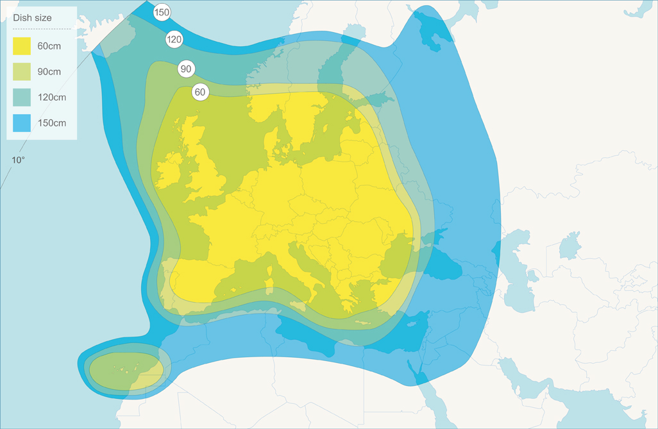
Dish Diameter Footprint ASTRA 3B at 23.5E

Slide 6















SES customers on 23.5E (examples)
Czech Republic & Slovakia: Skylink, CS Link
Benelux: Canal Digitaal, ROOS, TV Vlaanderen
Bulgaria: Satellite BG

Slide 7
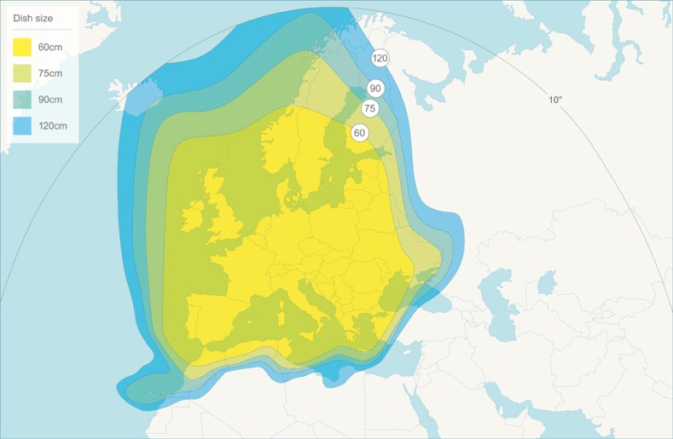

















SES customers on 19.2E (examples)
German speaking markets: ARD/ZDF, ProSiebenSat1, Sky, RTL Group
France: Groupe Canal+, France Televisions
Spain: Digital+
Benelux: Canal Digitaal, NOS, RTL Group, TV Vlaanderen
Poland: TVP
Serbia: Telekom Serbia (RTS Sat and Radio Beograd)

Slide 8













SES customers on 31.5E (examples)
Cable feeds for CME
Contribution for Ukrkosmos
Contribution for Tivuitalia

Slide 9
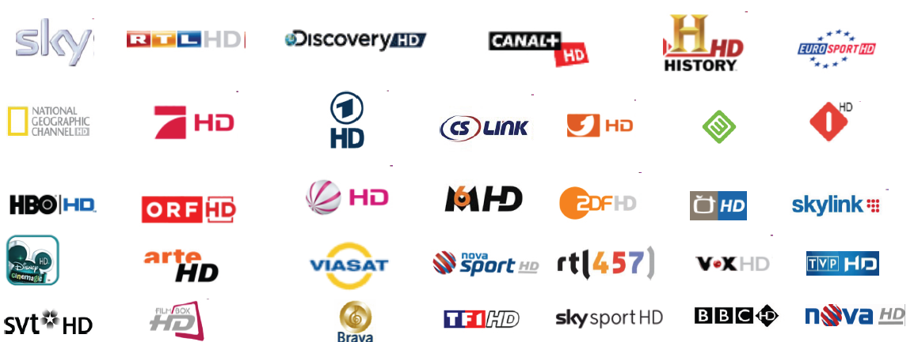

Currently more than 200 HD channels on ASTRA satellites

Slide 10







SES customers in CEE region
  Czech Republic & Slovakia,
  ASTRA 23.5E & ASTRA 19.2E
  Czech Republic & Slovakia,
  ASTRA 23.5E & ASTRA 19.2E
  Czech Republic & Slovakia,
  ASTRA 23.5E & ASTRA 19.2E
  Bulgaria, ASTRA 23.5E
  Romania, Bulgaria
  ASTRA 31.5E
  Poland, ASTRA 19.2E
  Croatia, ASTRA 23.5E
  Serbia, ASTRA 19.2E
10
10

Slide 11
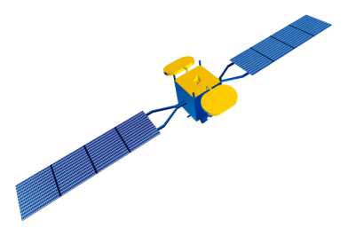





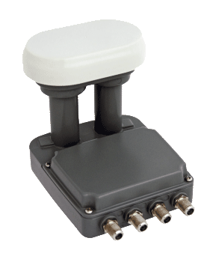














Case study: Czech Republic and Slovakia
Great choice of TV and radio channels on 23.5E (over 400 TV & radio channels)
provides attractive neighborhood for new DTH operators and broadcasters
More than 50 SD channels with Czech, Slovak, Hungarian, English audio within Skylink
and CS Link packages with constant extension of channel line up, new DTT channels are willing to broadcast via 23.5E position
17 HD channels in Skylink package – more HD channels to come
Attractive FTA offer on ASTRA 19.2E – nearly 300 TV and radio channels via Duo LNB
ASTRA 23.5°
ASTRA 19.2°
  SD channels*
  HD channels *
  FTA channels on 19.2E position *
  *Examples

Slide 12
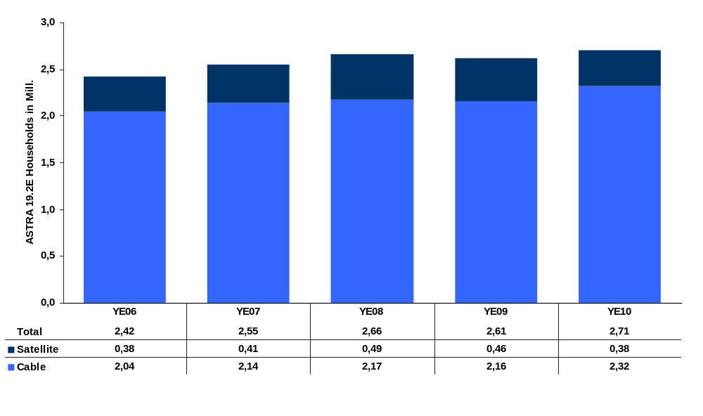
ASTRA Household Coverage in Hungary
Source: SES ASTRA, Hungarian Satellite Monitor, GfK Hungaria
12

Slide 13

DTT via satellite accelerates the digitalization
‘DTT via satellite’ operational across entire Europe (ASTRA examples: Czech Republic
and Slovakia, UK, France, Austria)
Ideal complementary solution
to DTT and other terrestrial infrastructures
One off payment for basic public and commercial channels (including HD)
Attractive pay TV channels also available
a la carte
Effective reach of homes beyond DTT coverage
Attractive free-to-air channels via satellite

Slide 14
Summary
ASTRA 23.5E position is one of the Europe’s fastest growing DTH hotspot
  2 million dishes pointed to 23.5E position in Czech Republic and Slovakia
  More than 400 TV and radio channels available
  Access to hundreds of free-to-air TV channels on 19.2E via Duo LNB
Free-to-Air reception from ASTRA satellites is very popular across CEE
High penetration through CATV operators – attractive and high quality content
Technical excellence of ASTRA satellites
More than 3500 active point of sales across CEE region
Support through technical and marketing experts
Excellent relationships with relevant trade, retailers and installer organizations

Slide 15

Köszönöm szíves figyelmüket!
Marcin.Deka@ses.com
Senior Sales Coordinator, Media & Broadband

