Slide 1
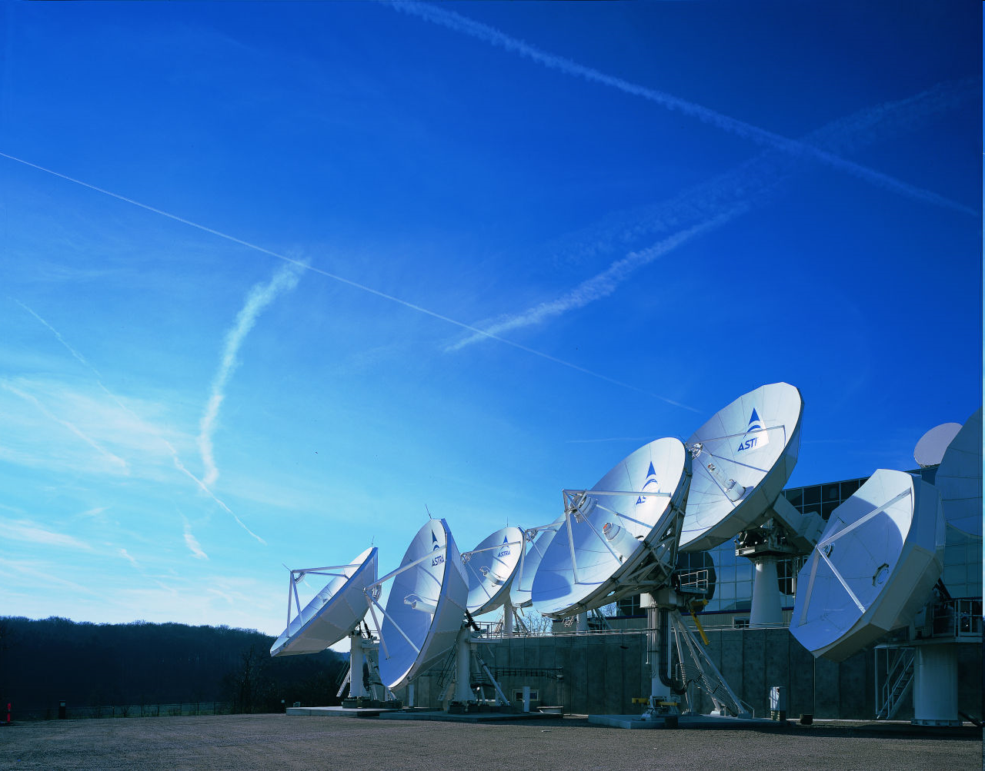
ASTRA Central Eastern Europe
- activities and marketing support
P-Sat Professional Day
Budapest, 27th October 2011

Slide 2
ASTRA CEE activities in short
Business development: contact on a daily basis to all main broadcasters and authorities in all 15 CEE countries in order to generate new business opportunities for SES.
Pre-sales, sales and after sales activities.
PR/PA activities: Participation in all market activities related to digitalization process (politicians, journalists, etc.), contacts with mainstream media across CEE countries, participation in most important events, lobbying activities among decision makers as well as local authorities (5 years of excellent personal relations).
Marketing activities on national and regional level: penetration marketing (nearly 2 mil dishes pointed to 23.5ºE in CZ & SK after 4 years, starting from ‘0’), trade marketing activities (more than 3500 point of sales, retailers, installers, etc.), cross media campaign conducted with ASTRA customers (Skylink/CS Link/AKTA/Satellite BG/Ocko TV), editorial & advertorial campaigns in trade as well as consumers magazines.
Local market research conducted together with customers in order to quickly adopt ASTRA proposition/services to very aggressive and dynamic market environment.

Slide 3
ASTRA CEE marketing support
ASTRA CEE supports its customers in their business planning and marketing activities
ASTRA CEE helps its partners to build reach – unique approach among satellite operators:
  More than 3500 trade partners in CEE region, more than 150 trade partners in Hungary
  Special free of charge info & promo materials prepared for all trade partners
  Regular trade meetings organized jointly with the customers
  Special incentive programs for POS and installers with very attractive prizes (e.g. trip to ASTRA HQ in Luxembourg)
  A dedicated web portal to all trade partners – POSM orders, requests for support, etc.
  Financial support for local MKT activities conducted by trade partners
Strong ATL/BTL activities & PR activities conducted jointly with the customer
ASTRA CEE is actively involved into the official informational campaign on the digitalization process (e.g. in Czech Republic and Slovakia)
Long-standing relationships with main hardware manufacturers and software devopers
Market research conducted by local agencies (e.g. GfK, TNS, etc.)

Slide 4
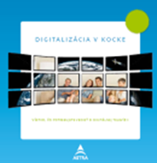
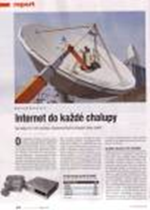



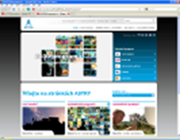
General marketing tools
Brochures
PR work
POS Materials
Advertising
Direct Mailings
Internet infoservice
ASTRA CEE Newsletter

Slide 5
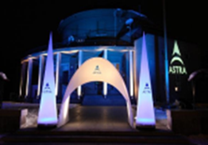
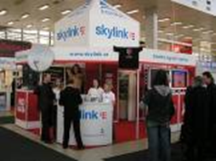

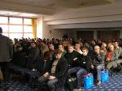
General marketing tools
Hospitality events
Fairs & Exhibition sponsorship
Press conferences
Trade seminars

Slide 6


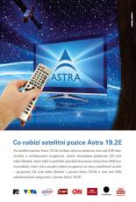

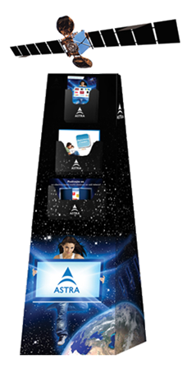

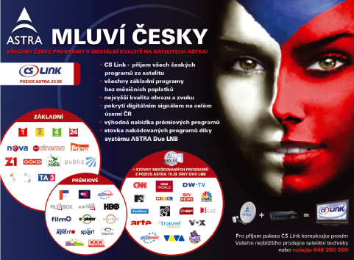
Examples of activities: POS materials
ASTRA POS materials for CEE retailers & installers
POS materials sent on a regular basis to more than 3500 POS across CEE region

Slide 7
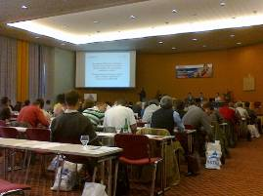
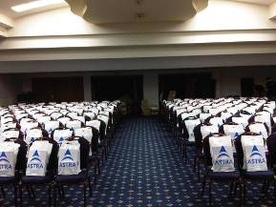
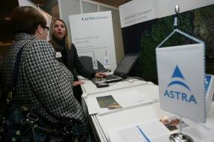

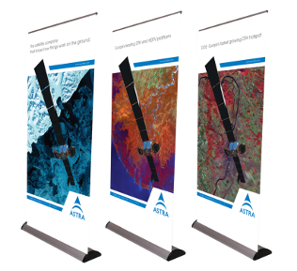
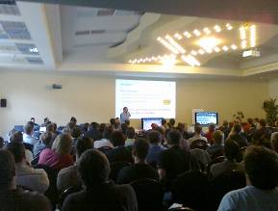
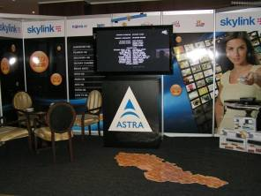
Examples of activities: ASTRA CEE Seminars
Regular trade meetings and trainings with satellite dealers and installers

Slide 8
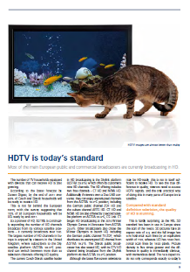
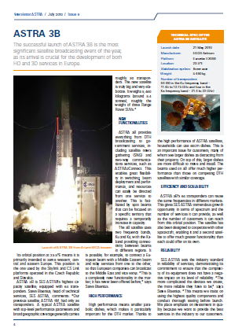
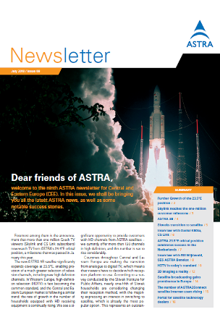
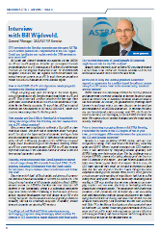
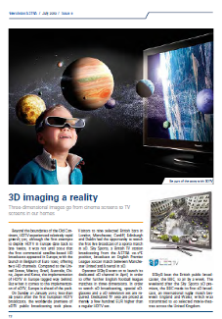
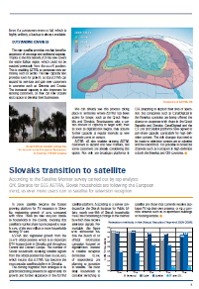
Examples of activities: ASTRA CEE newsletter
ASTRA CEE newsletter prepared regularly in 10 languages
Exclusive information on ASTRA and customers development in the region,
dedicated for journalists, POS, broadcasters and stakeholders

Slide 9
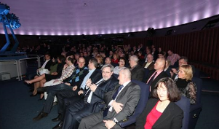
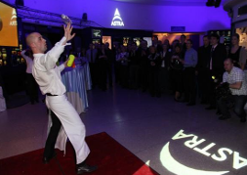

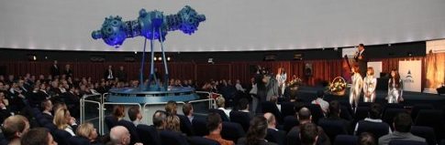
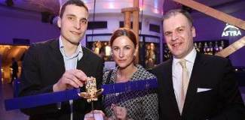
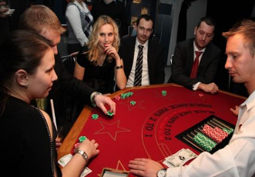
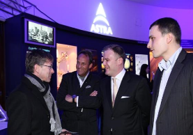
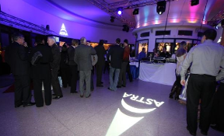
Examples of activities: ASTRA CEE hospitality events
Special hospitality events – e.g. celebration of 1 mil Czech TV households on ASTRA 23.5E position
9

Slide 10
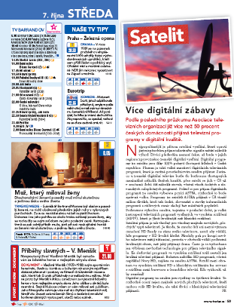
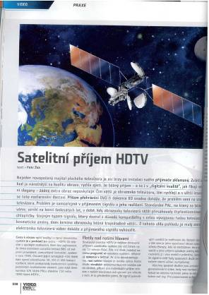
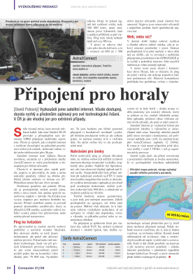
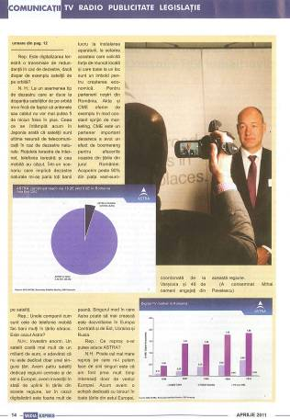
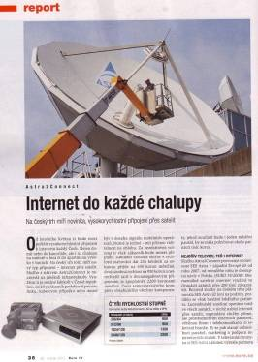
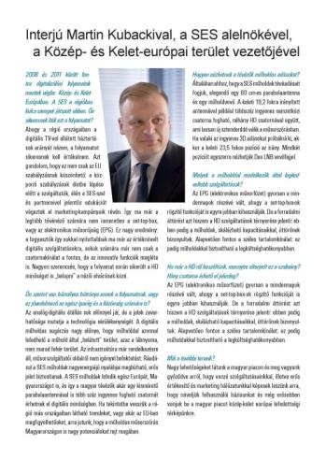
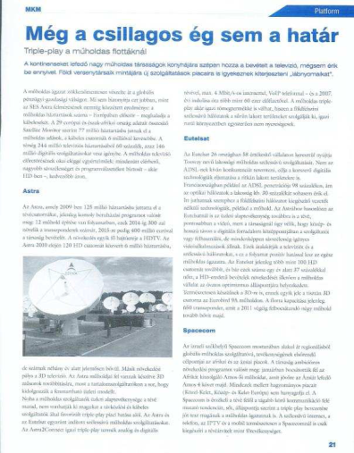
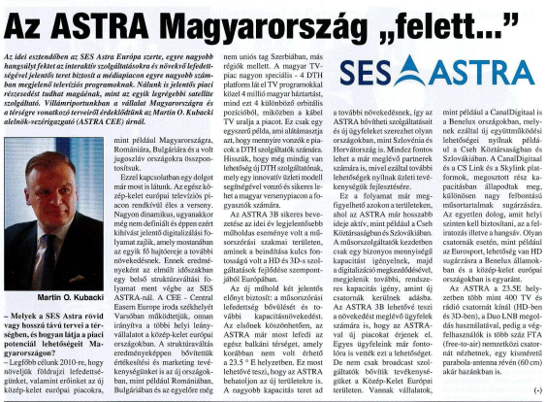
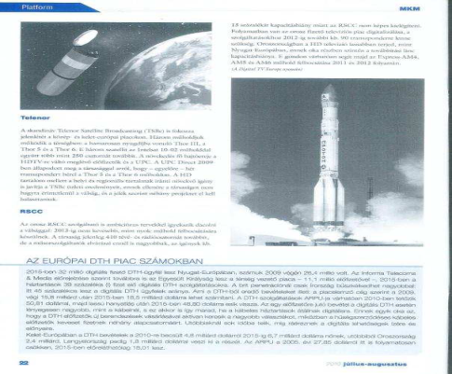
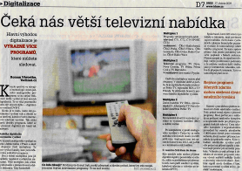
Examples of activities: ASTRA CEE PR activities
Extensive PR & editorial campaigns in various print and on-line media

Slide 11
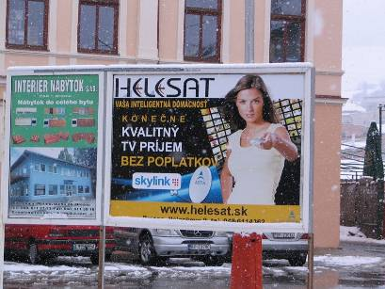
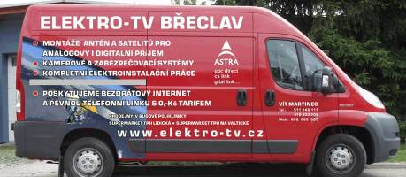
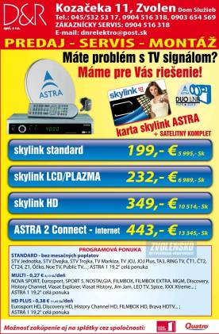
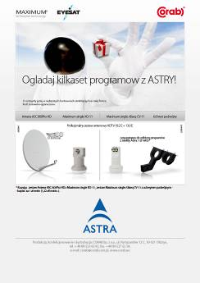
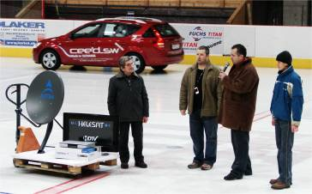

Examples of activities: ASTRA CEE local support
Know-how and financial support of local MKT activities performed by POS
Very well perceived by trade partners

Slide 12
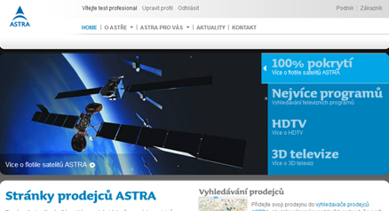
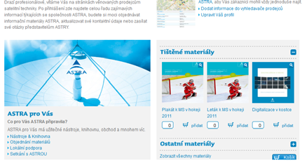
ASTRA CEE marketing activities
By the end of year - ASTRA marketing materials distribution:
Newsletter, Channel Line Up Leaflet, Calendar*, other
POS materials (hangers, T-shirts, stands for brochures)
Q1 2012 - EXTRANET
* http://www.astratalent.eu/hu

Slide 13
Köszönöm szíves figyelmüket! ☺
Joanna.Bienkowska-Stanczyk@ses.com

